Slide 1
2024 Parent meeting
CONTACT INFO: Ryan Doherty
Email: Ryan.Doherty@sussexvt.k12.de.us
Phone: 302-233-4490

Slide 2
Coaches
Varsity Coaches – Head Coach – Ryan Doherty
Assistant Varsity coach – Sean Forsyth
Head Jv Coach– Ryan Winkleblech
Volunteer game day Coach– Kevin Forsyth

Slide 3
FUNDRAISING
Why?
Philadelphia wings game
Practice equipment
Players equipment and gear
Communication
Game changes/ practice changes
One stop shop
Post videos / pictures
Stay connected with alumni/parents
Team store

Slide 4
FUNDRAISING

Slide 5
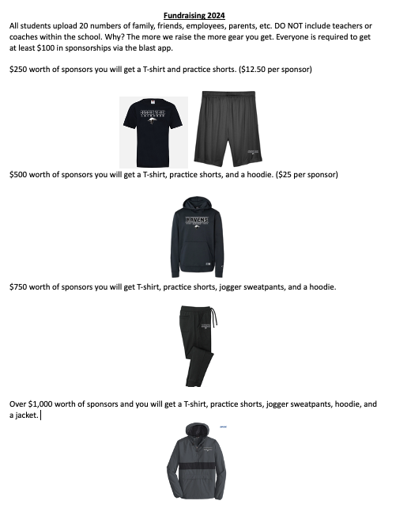
Fundraising

Slide 6
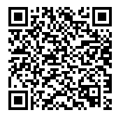
Team store

Slide 7
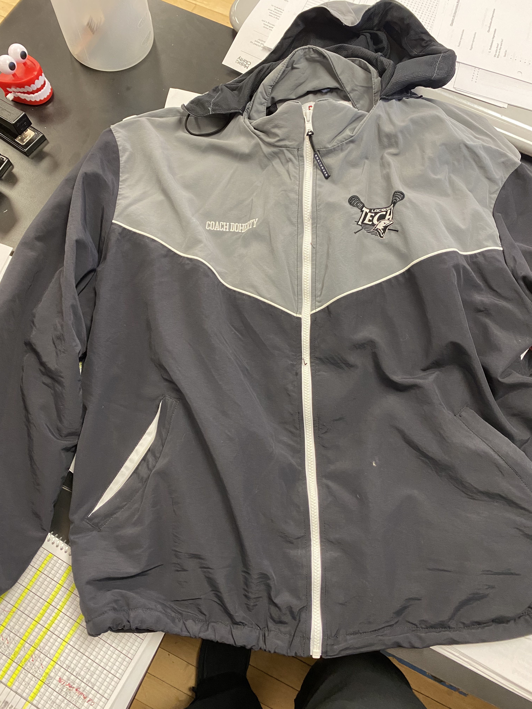
Boathouse jACKETS
6-7 weeks out for delivery
Information was given out.
Due March 8th
$165

Slide 8
Schedule Changes
Woodbridge game moved to 5p.m.
IF YOUR NOT SURE CHECK WEBSITE FOR SPORTS FROM THE SCHOOL WEBSITE.
WEBSITE4SPORTS
March 30th we will be going to the Philadelphia Wings game – depending on students interest we will be taking vans or a bus
Helmets – Voodoo lacrosse if you would like to purchase your own .
Practice everyday 3:40p.m - 5:30p.m- Juniors and seniors stay after if driving
Dress attire for games
Home games – khakis and button up dress shirt
If a student athlete does not have them – I will get them for them.
Away games – sponsor shirt
May change based on fundraising
film sessions
Very important for players to watch themselves on Hudl
Games will be uploaded within hours of the game. Home games uploaded immediately.
I can see who watches film and for how long

Slide 9
Appo play day – Saturday 3/9/24 - RAIN OR SHINE
Players should arrive by 6:40a.m. Bus leaves at 7 a.m.
First game is at 9a.m. on side turf
Planning on having a dress list.
Food trucks will be there if students want to bring money for food.
AWAY GAMES
Players will call for rides 30 minutes prior to us getting back
Please be sure to be at the school to pick up your student athlete when we get back from away games.
Please sign up for snacks for away games and also home games.
https://docs.google.com/spreadsheets/d/1KHsNlhfHowXDEsYVYkDQvdoQ62spZM3q28GxwlNF2r4/edit?usp=sharing
Home games can be a meal for student athletes to eat after the game or just snacks.

Slide 10
Our culture quick summary – BRING THE JUICE
We use “juice” as the energy and effort you display or give off at practice, games, school, or home
We like to say that we want to bring the RIGHT juice
Positive
Energetic
100% hustle
Respectful
Willing to learn
NO BCD’s
Main goal is to raise respectable and great young men that have a passion for the game of lacrosse.
Two hours a day isn’t enough – need to be working on the wall at home, watching the game – after schoolwork is done
Grades – MP3 ends 3/25/24 – must be academically eligible to remain on the team.

Slide 11
GO OVER Team Code of Conduct
We will have a rotating roster this year – student athletes based on practice performance will be placed on jv or varsity rosters.
If you have any questions please feel free to email me at
Ryan.Doherty@sussexvt.k12.de.us

