Slide 1
Welcome to
Vista High Football

Slide 2
TEAM SPIRIT PACK!
Be a part of the family with your own “Spirit Wear Pack plus Transportation” package!
Each day of the week the team is
REQUIRED to wear a specific color
at practice.
Camaraderie and unity on the field
Check out the new 2020 Spirit Pack LOGO!

Slide 4
“The panther Pack”
SPIRIT PACK + TRANSPORTATION = $280.00
Included in the Spirit Pack
2 Tees
Comppression Shirt
Pair of shorts
All parents are Booster Member
Please pay using Venmo or Cash/Check at time of pick up
Please see our Venmo below. If using Venmo, please add the following.
Player Name: - Level – Parent Name – 2020 Spirit Pack

Slide 5
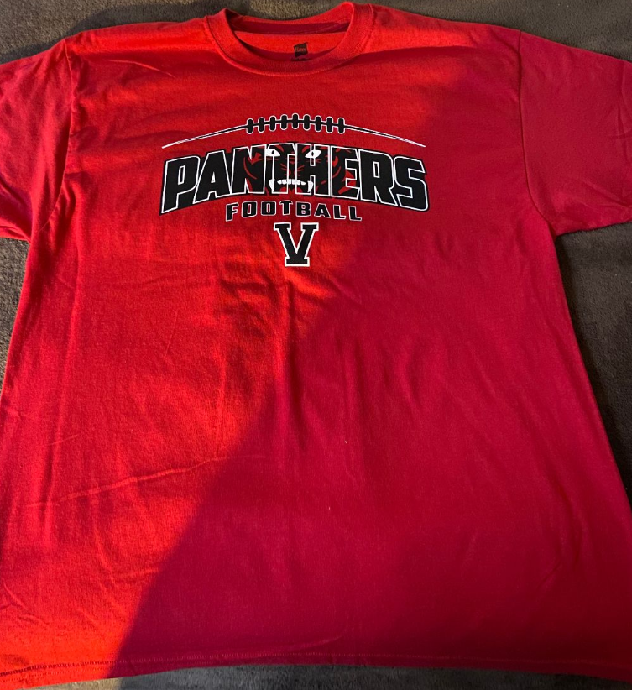
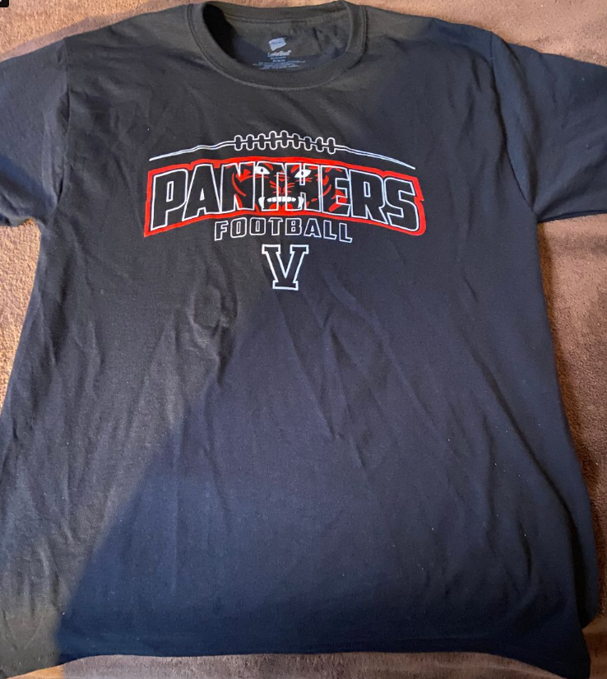

Slide 6
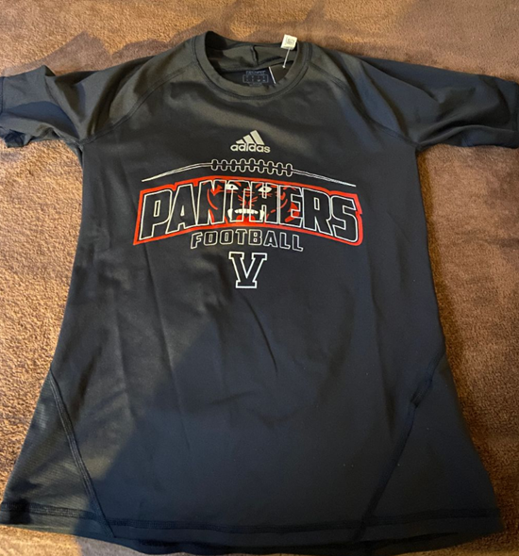
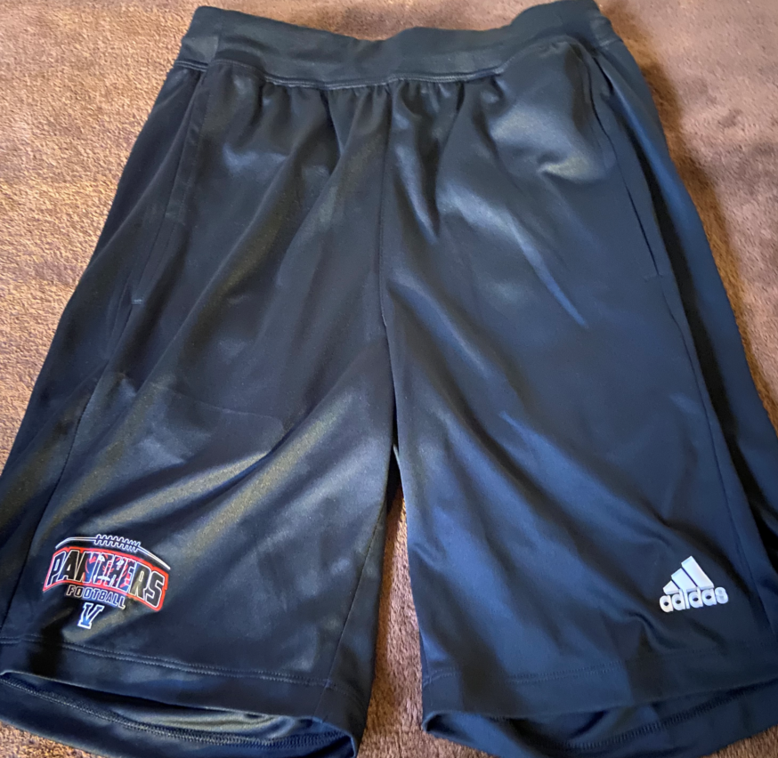
Compression Shorts & Shirt

Slide 7
~ Please fill out this sheet and bring with you to pick up your spirit pack ~
2020 VHS FOOTBALL PLAYER INFORMATION SHEET
Player Name: |  |  |  | Frosh - JV - Varsity (circle one)
Parent Name: |  |  |  | Additional Contact
Address |  |  |  | Cell Phone
City |  | Zip |  | Email
Cell Phone
Email
2020 PANTHER FOOTBALL PURCHASES
 |  | COST | QTY | Total
 | PLAYER PACK SPIRIT PACK/TRANSPORTATION | $280.00
Date:
Parent Signature:
Signature acknowledges receipt of spirit pack
Booster Board Member:
Check Number_______________
CREDIT CARD_______________
VENMO____________________

Slide 8
TRANSPORTATION
VHS Football gets not one penny from the district nor the school for transportation to our away games?
This huge cost is paid entirely by our “Spirit Wear Pack and Transportation” package that you can purchase tonight!

Slide 9
EXTRA! EXTRA! Read all about it!
Purchase space in our
amazing program!
Every cent goes straight to VHS Football.
You can give a shout out to your son.
Advertise your company or a company that you would like to support.
Hit the pavement! Ask businesses in the area to support us!

Slide 10
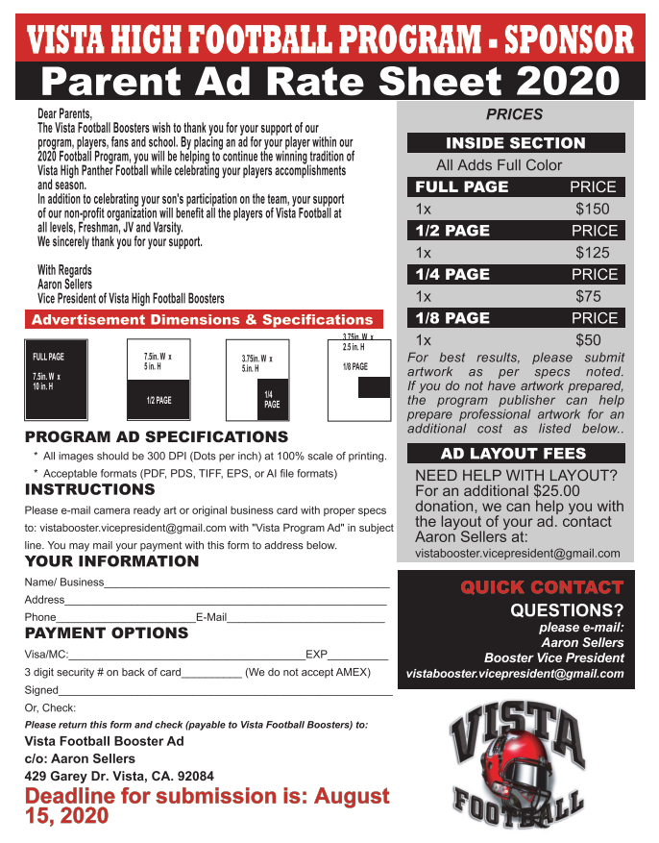
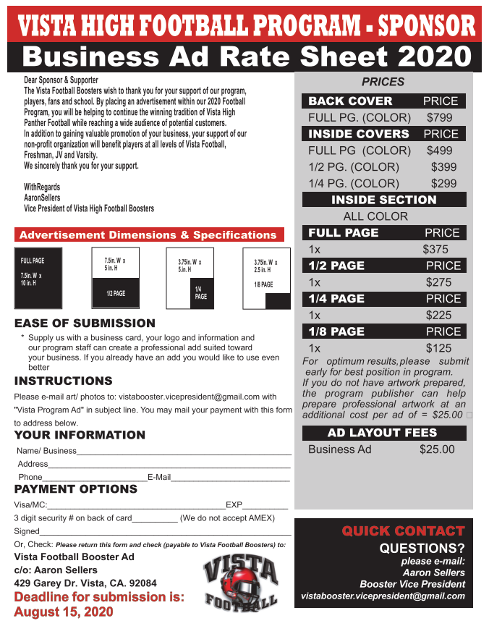

Slide 11
paperwork:
Sports Physical
Athlete agreement
information:
Blast athletics
Hudl
Maxpreps
volunteers:
We need YOU!
SNACKBAR
Team dinners
Team feeds
Sack lunches
Film a game
Donate
Booster meetings

Slide 12
Upcoming Events to remember!
Sports Physicals
FIRST DAY OF PRACTICE
Mom’s Clinic
Youth Football and Military Night
Homecoming

Slide 13
Vista Fundraising Parking Lot Party!
Point System, 10 points gets you into the PARKING LOT PARTY!
Did you ever want to throw a pie in the face of your coach? See your coach sing karaoke?
Football players ONLY event!
10 fundraising points is the ONLY way to get in! Bring your Lawn Chair and be ready to laugh.
How to Earn Points
Blast, 20 contacts =1 point
E- Card Sales, 5 cards sold = 2 pts
Program ads, Business Ads: 2 points for every ad sold, 3 pts for full page, 4 pts full page inside cover and 5 pts for back cover. Parent ads 1 pt for every 2 ads sold.
Banners, 2 points for every banner sold
Volunteer Hours, 1 pt for every 2 hr shift (ask fundraising coordinator for details).

Slide 14
How to earn pts | minimum | point value | expectation | meet expectation
Blast | 20 contacts | 1 pt | 40 contacts | 2 pts
E-Card | 5 sold | 2 pts | 10 sold | 4 pts
Program ads | 1 sold | 2 pt | 2 sold | 4 pts
Parent ads | 2 sold | 1 pt
Volunteer | 2 hrs | 1 pt
40 Contacts + 10 E-Cards Sold + 2 Program Ads Sold = 10 Points!
10 Points = VIP Parking Lot Party Pass
Turn points in at vistafootballprograms@gmail.com

Slide 15
E-Card
$20 Card
Discounts on front and back
Sell 10 get 4 points!
We earn $17 for every card sold
10 Cards sold per player
133 players
$22,610 raised
First player to email
Card sales kick off begins July 1!!

Slide 16
Kick off June 1st
Every player turns in 40 contacts!!!
Fundraising Video sent via Email and Text
Currently at least 20 contacts per player turned in: Varsity 32 /JV 15 / Freshman 0
Currently 40 contacts per player turned: Varsity 9 /JV 0 / Freshman 0

Slide 17
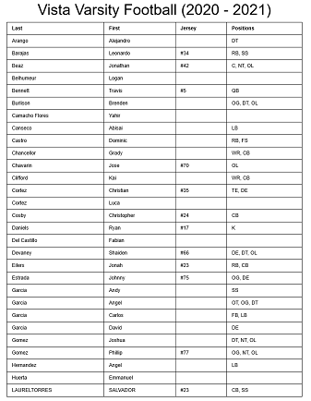
Player Lanyards $15 Parents show your team spirt & support your player Available to order August 15th
Front
Back
*Layout subject to change

Slide 18
Questions?
vistabooster.president@gmail.com
vistabooster.vicepresident@gmail.com
vistabooster.secretary@gmail.com
vistabooster.treasurer@gmail.com
vistabooster.treasurer2@gmail.com
vistafootballprograms@gmail.com
Check us out!
Facebook: Vista Panther Football Boosters
Instagram: vistapantherfootball

