Slide 1
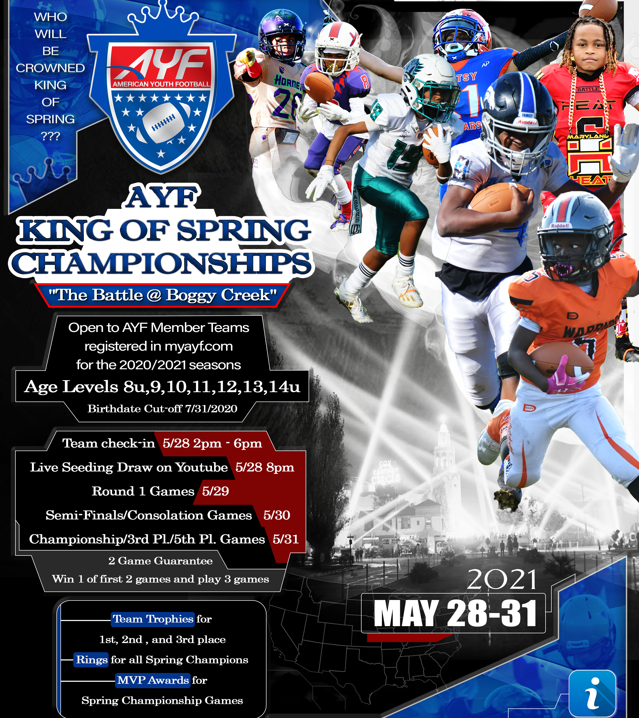
AMERICAN YOUTH FOOTBALL
2020 KING OF SPRING CHAMPIONSHIPS
“The Battle @ Boggy Creek”
May 28th-31st
^{Divisions 8u-14u}
2 GAME GUARANTEE

Slide 2
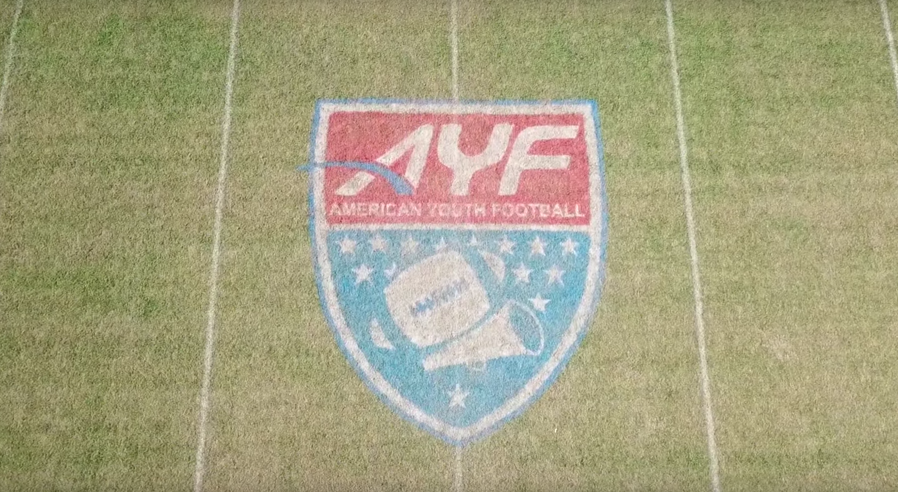
INFORMATION PACKET
All Events Held @ Austin Tindall Sports Complex 4100 Boggy Creek Rd Kissimmee, Fl 34744
May 28th 2pm-6pm Mandatory Team Check-in
May 28th 7pm Random, Seeding Draw
May 28th 8pm Mandatory Head Coaches Meeting
May 29th 9am-9pm Round 1 of Games
May 30th 9am-9pm Semi-Finals/Consolation Games
May 31st 9am-7pm Championship,3rd Place,5th Place Games
Team Trophies for 1st , 2nd, and 3rd Place Teams
Rings for King of Spring Champions
MVP Awards for Championship Game MVPS

Slide 3
INFORMATION PACKET
OPEN TO ALL FALL TEAM 2020 ROSTERED TEAMS
OR SPRING 2021 ROSTERED AYF TEAMS REGISTERED IN MYAYF.COM
AGE CUTOFF IS AGE AS OF 7/31/2020
ACCEPTABLE FORMS OF PROOF OF AGE : STATE PHOTO ID FROM DMV, U.S. PASSPORT, BIRTH CERTIFICATE W/PLAYER PHOTO ON REGISTRATION PAPER WORK
ROSTERS AND $500.00 PER TEAM DEPOSITS ARE DUE ON 3/01/2021 BALANCE WILL BE DUE ON 4/15/2021 NO EXCEPTIONS OR YOUR TEAM WILL BE REPLACED (DEPOSIT IS NON-REFUNABLE) WITH A TEAM ON THE WAITING LIST ON 3/05/2021 NO EXCEPTIONS
TOTAL COST IS $50.00 PER PLAYER TO PARTICIPATE
MINIMUM ROSTER IS 16 PLAYERS AND MAX 36 PLAYERS AT TEAM CHECK-IN TO PARTICIPATE. IF YOU SUBMIT A ROSTER OF 20 PLAYERS AND SHOW UP WITH 18 YOU WILL NOT RECEIVE ANY REFUND FOR NO SHOW PLAYERS
IF YOU HAVE 16 PLAYERS YOUR TOTAL WILL BE $800.00 TO PARTICIPATE
ROSTER TEMPLATES WILL BE SENT TO EACH TEAM ONCE YOU HAVE BEEN SELECTED/CONFIRMED FOR THE TOURNAMENT
ROSTERS NEED TO BE SENT TO KINGOFSPRING2021@GMAIL.COM

Slide 4
INFORMATION PACKET
TEAM SELECTION PROCESS
EACH DIVISION WILL HAVE 8 TEAMS
7 DIVISIONS OF PLAY 8u 9u 10u 11u 12u 13u 14u
56 TOTAL TEAMS WILL COMPETE TO BE KING OF SPRING
ROSTERS AND FINAL PLAYMENT ARE DUE ON 4/1/2021
ON 4/5/2021 IF FINAL PAYMENT ISN’T MADE AND ROSTER ISN’T RECEIVED YOU WILL BE REMOVED FROM THE BRACKET AND A TEAM ON THE WAITING LIST WILL TAKE YOUR PLACE.

Slide 5
INFORMATION PACKET
PAPERWORK
REQUIRED PAPERWORK FOR TEAM, PLAYERS, & STAFF WILL BE SENT TO EACH TEAM AFTER YOU HAVE BEEN SELECTED FOR PARTICIPATION
INSURANCE
EACH TEAM IS REQUIRED TO PROVIDE TEAM INSURANCE IN ORDER TO PARTICIPATE IN THE EVENT
PROOF OF INSURANCE IS REQUIRED AT TIME OF FINAL PAYMENT (YOU WILL UPLOAD A COPY DURING PAYMENT)
MINIMUM REQUIREMENT IS BELOW
$100,000.00 ACCIDENT PER INCIDENT
$1,000.000.00 GENERAL LIABILTY PROTECTION
IF YOU NEED TO PURCHASE INSURANCE PLEASE CONTACT SADLER INSURANCE
https://www.sadlersports.com/ayf/

Slide 6
TOURNAMENT RULES
All GAMES WILL BE OFFICIATED BY FLORIDA OFFICALS AND FOLLOW NFHS GUIDELINES EXCEPT FOR MODIFICATIONS LISTED BELOW
EACH GAME WILL CONSIST OF FOUR 10 MINUTE QUARTERS FOR ALL AGE GROUPS 8U-14U.
EACH TEAM WILL RECEIVE 3 TIMEOUTS PER HALF. TOTALING 6 PER GAME.
ALL SPECIAL TEAMS WILL BE LIVE… PUNTS, KICK-OFFS, AND EXTRA POINTS.
PATS BY KICK WILL BE FOR 2PTS, ALL PATS BY RUN OR PASS WILL BE FOR 1PT.
KICK-OFFS WILL BE PLACED AT THE. 40 YARD LINE FOR ALL AGE LEVELS 8U-14U
EACH TEAM WILL PROVIDE THEIR OWN FOOTBALL.
8U-10U WILL USE K2 FOOTBALLS, 11U AND 12U WILL USE TDJ FOOTBALLS, AND 13U-14U WILL USED TDY FOOTBALLS
LOPSIDED RULE OF A RUNNING CLOCK FOR THE REMAINER OF THE GAME WILL GO INTO EFFECT ONCE THE SCORE HAS A 35 PT DIFFERENTIAL OR A TEAM HAS SCORED 5 TDS. THE CLOCK WILL ONLY STOP FOR TIMEOTS AND INJURIES .
OVERTIME WILL BE FROM THE 10 YARD LINE. EACH TEAM WILL RECEIVE 1 SET OF 4 DOWNS, IF THE SCORE REMAINS TIED AFTER THE INITIAL SET IT WILL CONTINUE IN THE SAME MANNER UNTIL A WINNER HAS BEEN DETERMINED.
BEFORE EACH GAE ALL PLAYERS MUST GO THROUGH A FACIAL CHECK WITH AYF OFFICIALS AT THE FIELD.
ALL TEAMS MUST ARRIVE AT THE DESIGNATED FIELD OF PLAY AT HALFTIME OF THE GAME BEFORE WITH TEAM IDS USED AT TEAM CHECK-IN TO GO THROUGH THE FACIAL VERIFICATION PROCESS.
ANY TEAM(S) CAUGHT CHEATING WILL BE AUTOMATICALLY REMOVED FROM THE TOURNAMENT.
ANY TEAM(S) INVOLVED IN A TEAM FIGHT (BENCH CLEARING) OR OTHER WILL BE REMOVED FROM THE TOURAMENT.
PLAYER EJECTIONS FOR 2 UNSPORTSMANLIKE (NON-FIGHTING) INFRACTIONS WILL BE SUSPENED FOR THE FIRST QUARTER OF THE NEXT SCHEDULED GAME NO APPEALS WILL BE HEARD.
PLAYER EJECTION FOR PUNCHING, KICKING, OR FIGHTING WILL BE SUSPENDED FOE THE FIRST HALF OF THE NEXT SCHEDULED GAME NO APPEAL WILL BE HEARD.

Slide 7
ANY QUESTIONS PLEASE CONTACT
CRAIG KARAHUTA
VP FOOTBALL & CHEER OPERATIONS
732-552-6825
craig@americanyouthfootball.com

