Slide 1
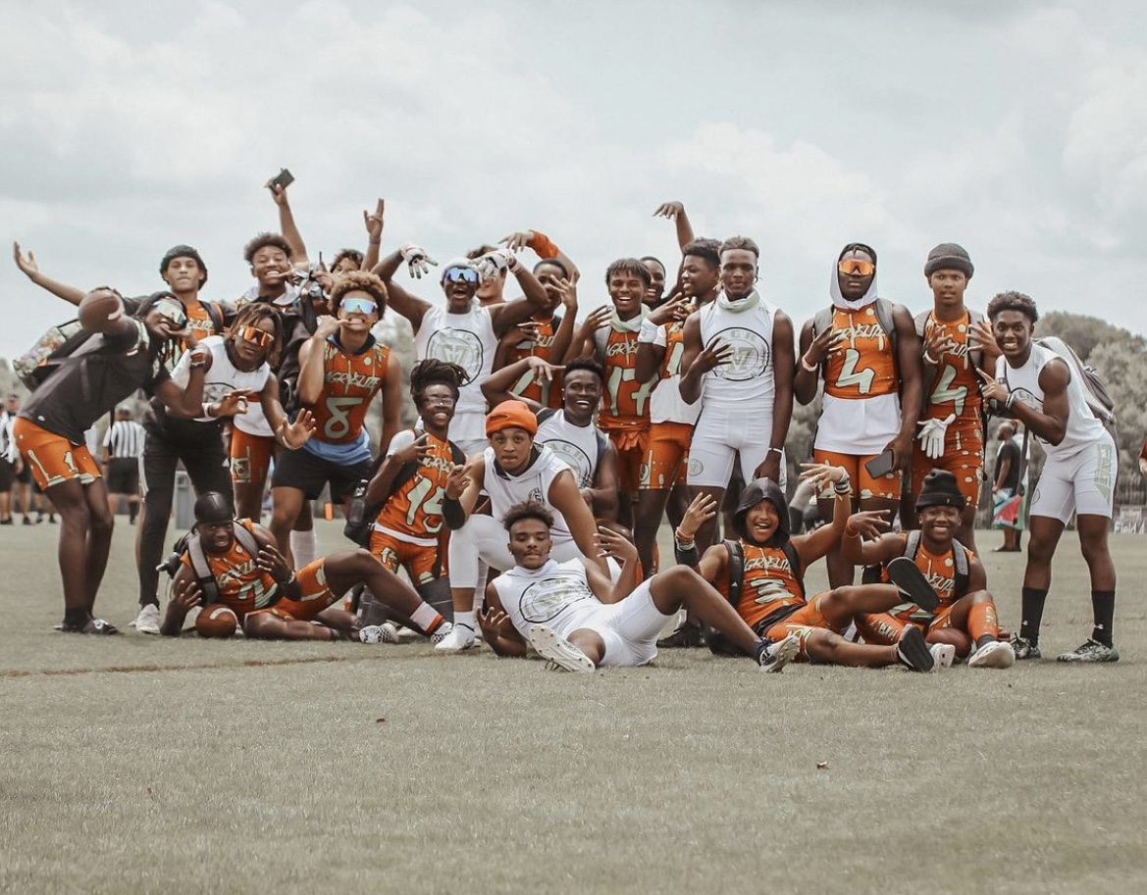
Welcome

Slide 2
Introduction- About Us
Athletes Get Recruited Inc (AGR) is a privately-owned company created to assist student athletes and their parent(s)/guardian(s) in obtaining an athletic scholarship to a college/university.
Through education, experience and exposure we put the student athletes and their families in control of the recruitment process since we understand that this is your future at stake.

Slide 3
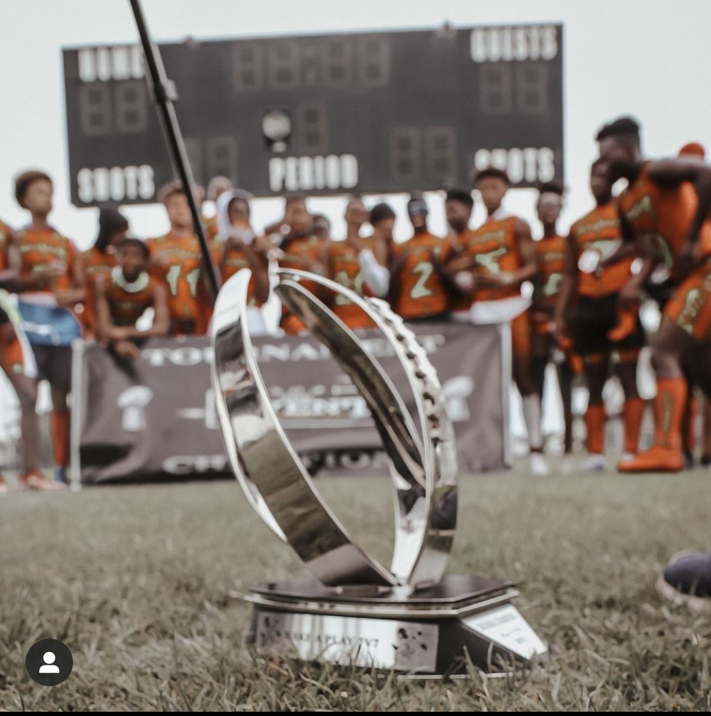
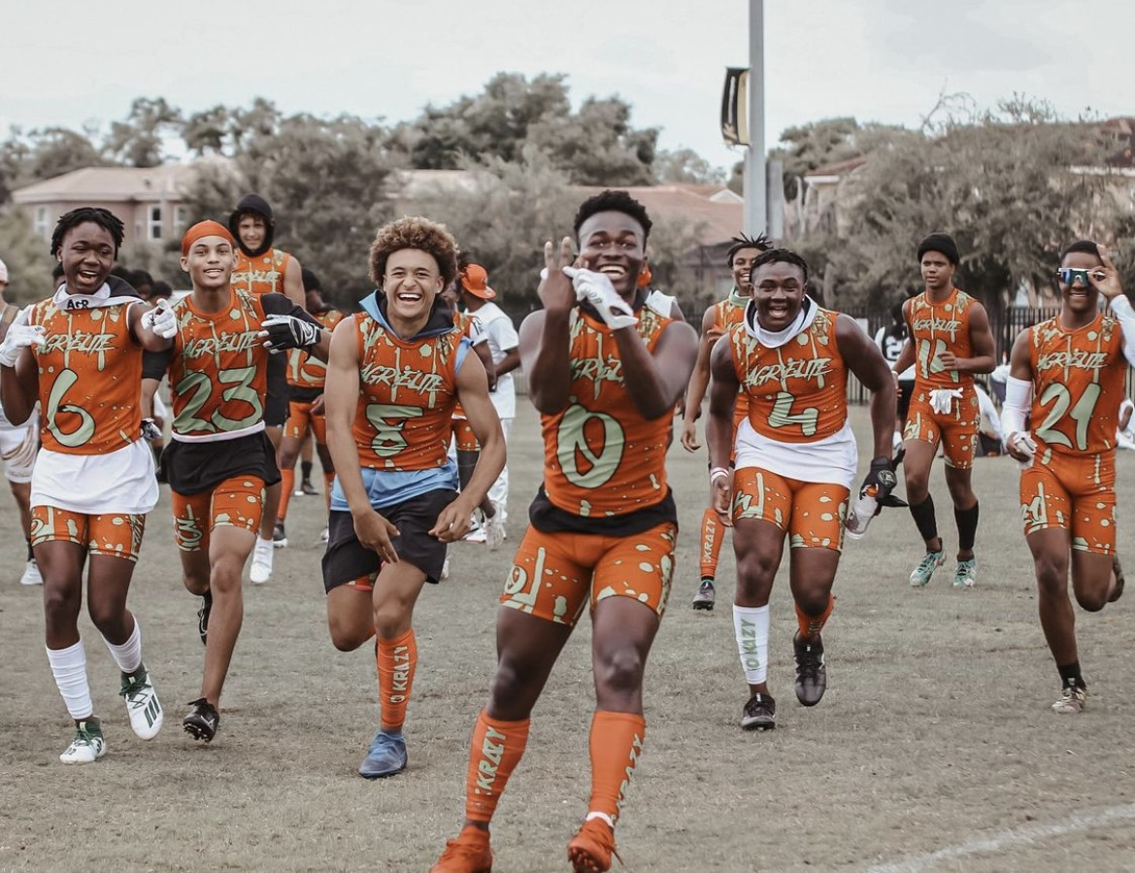
Agr elite team forms
Team Cost
Team Schedule(s)
Player Waiver
Covid Testing
Parent Checklist Data Sheet
Fundraising
Notes:
At this point we can share screen and I can showcase the sheets individually from my laptop.

Slide 4
Agr elite teams
AGR Blue 18 U
National Travel Team
Notes:
At this point we can share screen and I can showcase the sheets individually from my laptop.

Slide 5
team fEEs
Team Cost
Practice Venue
Player Pack
Uniforms
Sweat Suits
Book Bags
Fundraising
Covers Transportation, Housing and Tournament cost.

Slide 6
Player PAck
Team Cost - $450
Player Uniforms
Book Bags
Cleats
Sweatsuits
$450 paid in full by March 5th
Half-payment by Feb. 26th

Slide 7
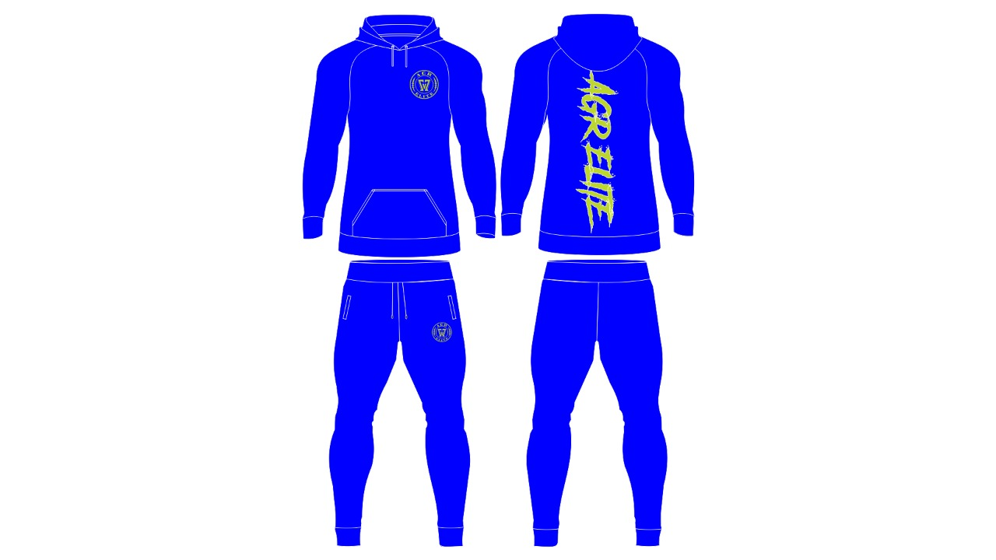
Player Pack

Slide 8
Schedule
* Tentative Tournament dates
Feb 19-20th Atlanta, GA *
Feb 26th Knoxville, TN * may change
Mar 11th -14th Miami, FL*
Mar 19th Atlanta, GA
Apr 9-10 Charleston , SC
April 16th Atlanta, GA
Apr 30th Columbia, SC *
April 23-24th Birmingham, AL
May 28-29th Atlanta, GA

Slide 9
Fundraising
Blast Athletics
Popcorn Fundraiser
Digital Ad Sponsors
Team Sponsor
Fundraiser Goal: $20,000
Fundraising will help cover:
Practice Venue
Tournament Fees
Transportation
Lodging
Food
Fundraiser: $850

Slide 10
Blast Athletics

Slide 11
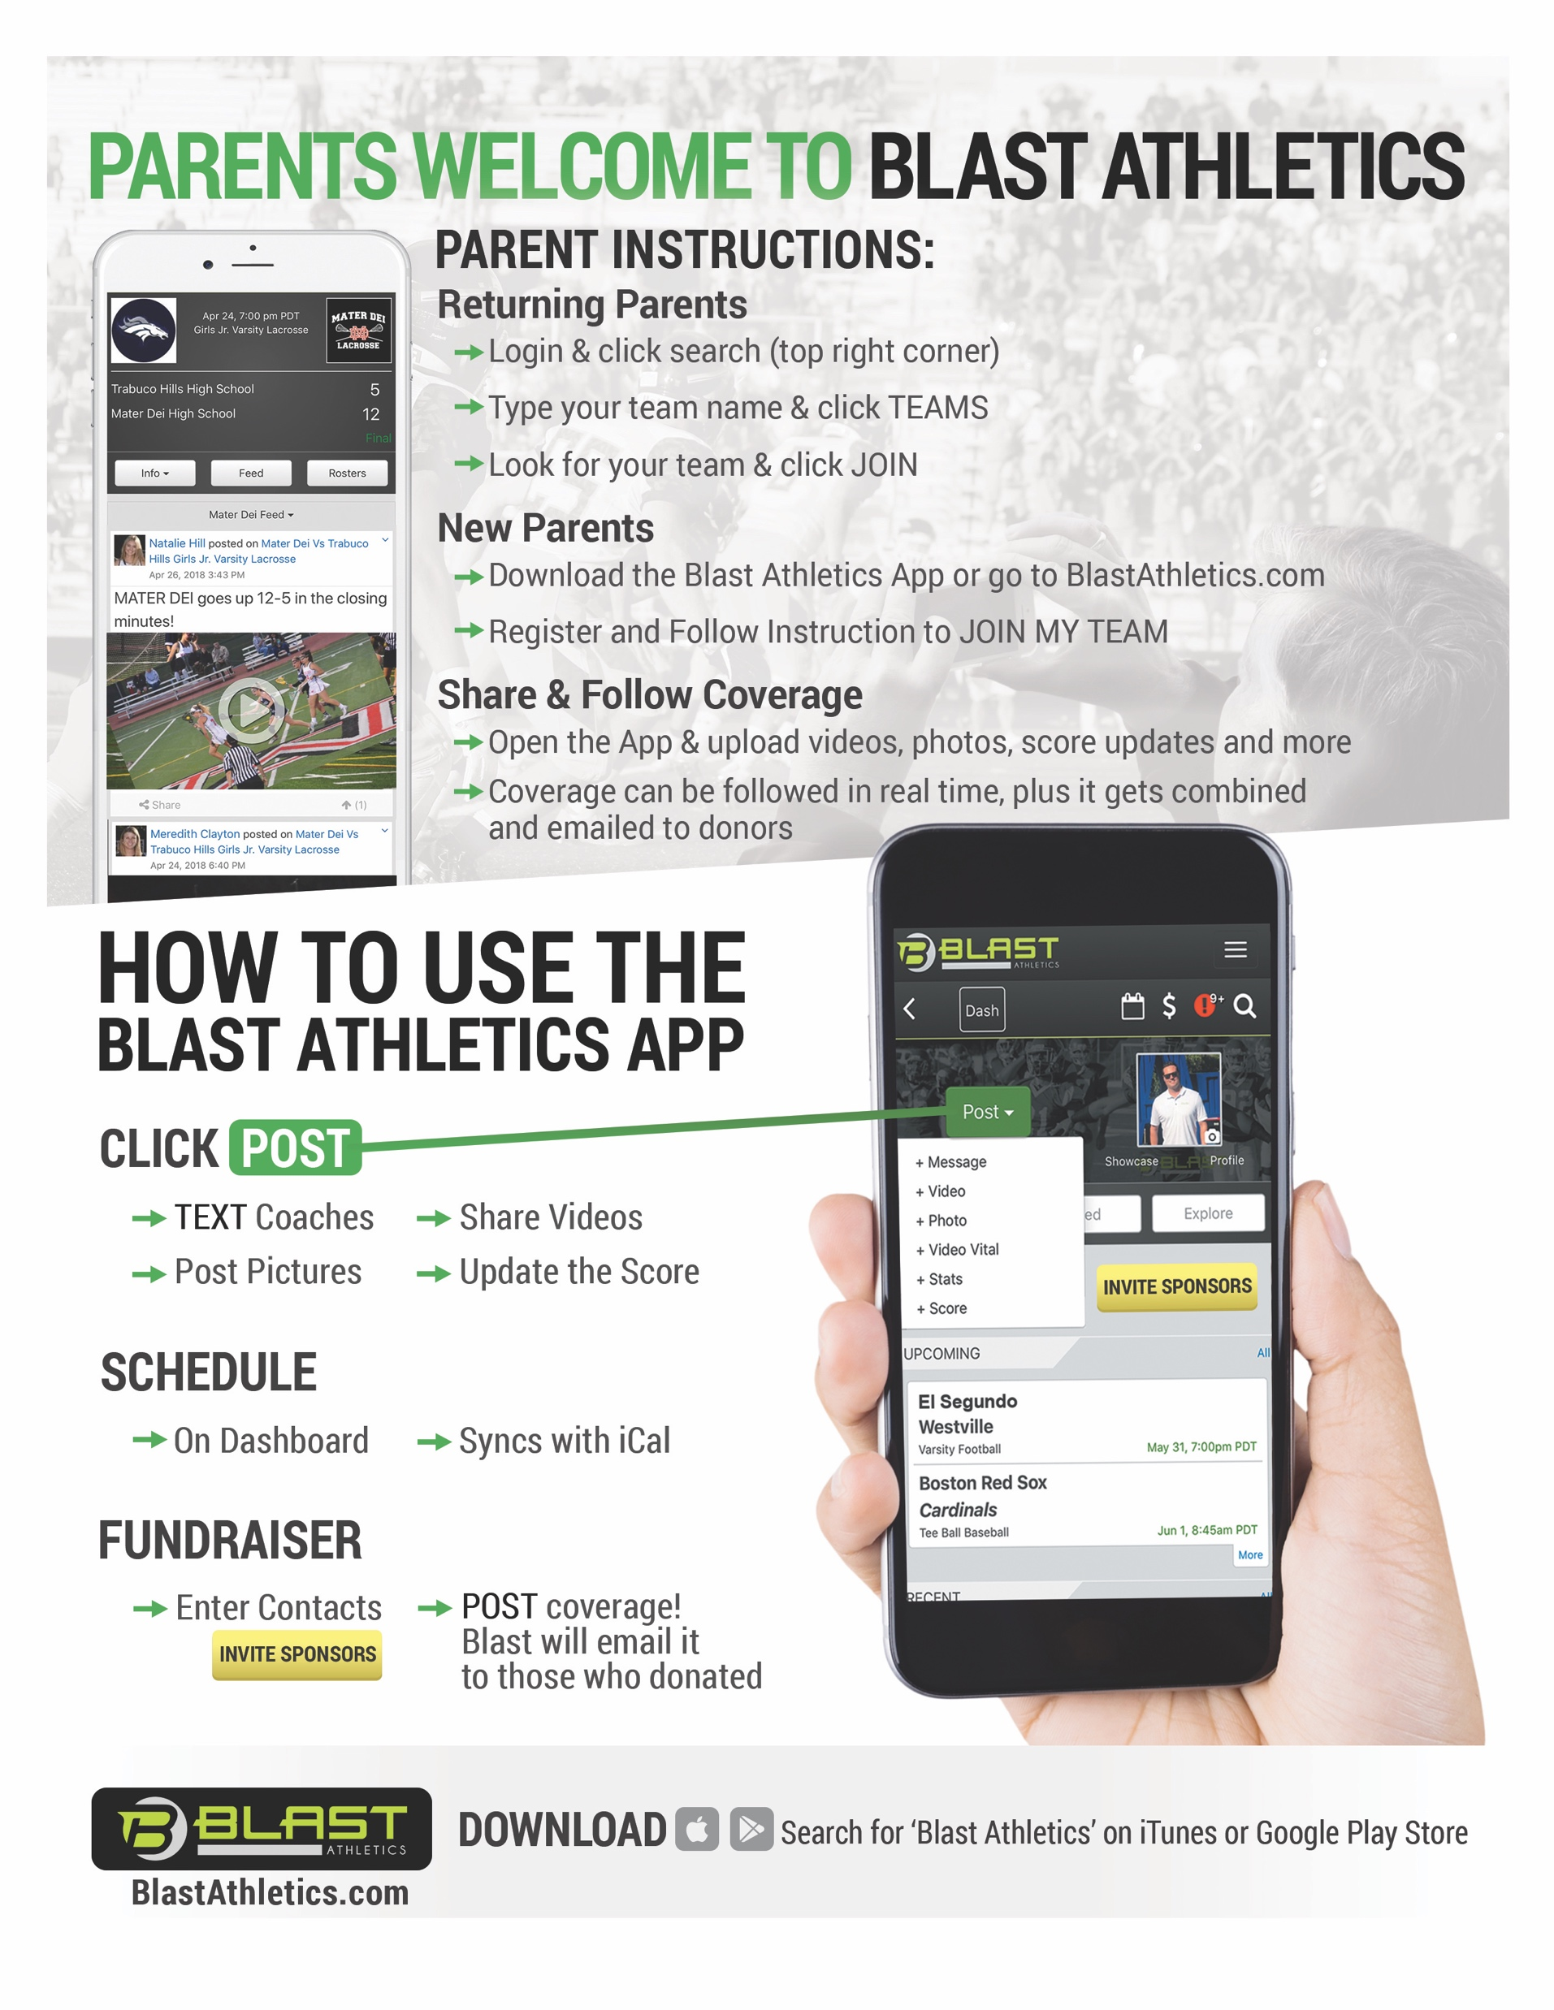
Blast Athletics
Practice Schedule updates
Tournament Info
Travel Updates
Important Forms

Slide 12
Parent Roles
Parent Coordinator
Lodging Coordinator
Transportation Coordinator
Tournament Coordinator
Food Coordinator

Slide 13
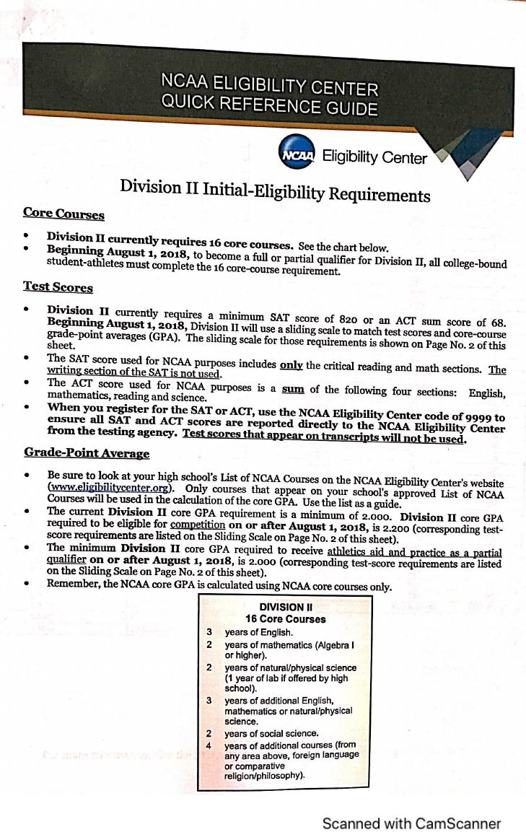
Recruiting

Slide 14
Social media
Twitter: @AGR_Recruiting
Instagram: @Agr_recruiting
Facebook: Athletes Get Recruited, Inc

Slide 15
Coach Norman
803-238-8691

