Slide 1
JSerra Girls Soccer
Varsity

Slide 2
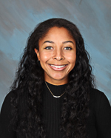
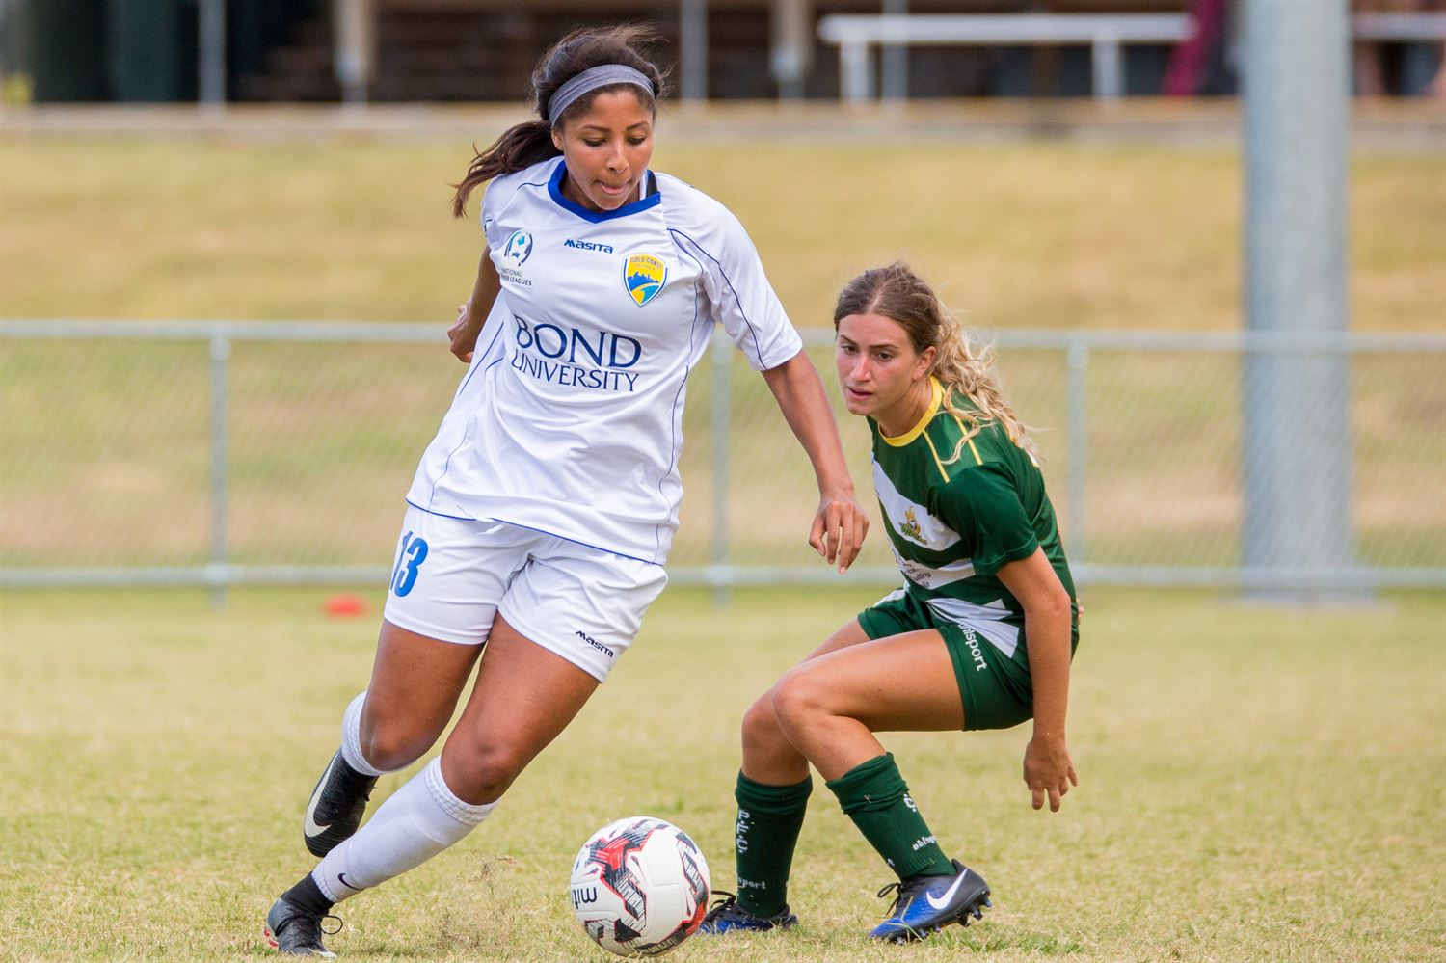
Coaches Intro
JSerra Catholic High School
Faith. Intellect. Character.
Anjel Brown
Head Varsity Coach & Program Coordinator
SCU student-athlete alumni
Starting defender on top 10 college team in the nation
Played professionally overseas (~3 yrs)
So Cal Blues native
HS Valedictorian, NHS, club president, 2 jobs, club, and high school soccer

Slide 3
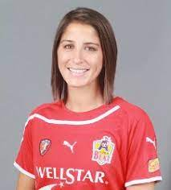
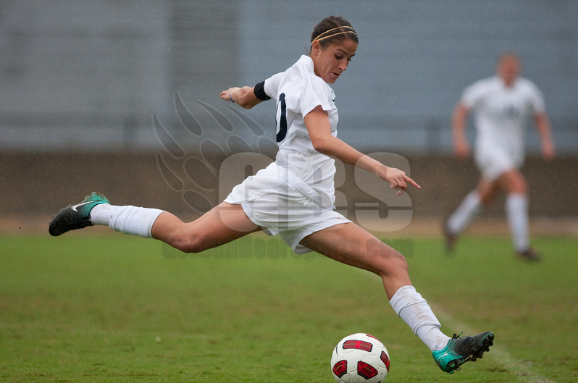
Coaches Intro
JSerra Catholic High School
Faith. Intellect. Character.
Megan Jesolva
Assistant Varsity Coach
Cal student-athlete alumni
Played professionally for 3 years
Youth national camps U15-U23
Slammers FC native
Certified yoga instructor
Marathon runner (qualified for Boston)

Slide 4
About the Program
JSerra Catholic High School
Faith. Intellect. Character.
Pride Pals
Varsity players get JV and Frosh player to support throughout the season
Write each other pregame pump-up letters
Exchange contact info as a mentor/friend
Keeps all teams connected– 3 teams= 1 program

Slide 5
About the Program
JSerra Catholic High School
Faith. Intellect. Character.
ALL IN
Accountability on your actions & behavior
Limitless mentality
Lion pride
Independent growth for dependent success
Never give up on yourself or your team

Slide 6
About the Program
JSerra Catholic High School
Faith. Intellect. Character.
Philosophy
ALL IN
Practice attendance
Attitude & effort
Coachable
Determination (each player is in control of their own playing time)
Notes:
If they want it, they just have to earn it.
No player “owns” a position. All positions are constantly evaluated.
No player is “limited” in this program. Always opportunities.
Players will be challenged and pushed beyond their own limits
Communication skills – players need to practice advocating for themselves first
Putting the “extra mile”

Slide 7
About the Program
JSerra Catholic High School
Faith. Intellect. Character.
Requirements
Academics: 2.5 GPA
Trust/respect one another
Advocate for yourself & practice effective, healthy communication
Face adversity/embrace opportunities
2 coaches’ evaluation meetings in the season (mid-preseason and end of season)

Slide 8
Athletic Eligibility
JSerra Catholic High School
Faith. Intellect. Character.
Athletic Clearance
Go to https://www.athleticclearance.com/
Click on “California”
Click on “Register”
Once registered and logged in, click “Start Clearance Here”
Print Confirmation Page to turn in to Athletic Training Department
Physical Examination submitted to Athletic Clearance
Website with more information: https://www.jserra.org/parents-students/fees-forms/eligibility

Slide 9
Athletic Eligibility
JSerra Catholic High School
Faith. Intellect. Character.
Academics
Must maintain a minimum 2.0 GPA to see field time
Game Day Absences
Must attend half of the school day on a game day to be eligible to play
Injuries
Must be cleared with our JSerra trainers before allowed to return to practice or games

Slide 10
Soccer Gear
JSerra Catholic High School
Faith. Intellect. Character.
Practice
Uniforms
Crimson tops
2 SS
1 LS
2 black shorts
2 black crew socks
1 backpack
Home Kit
Black jersey
Black shorts
Black socks
Away Kit
White jersey
Crimson shorts
White socks

Slide 11
Photo Day
JSerra Catholic High School
Faith. Intellect. Character.
Black uniforms
Wear cleats!
Nov. 28 after school
3:30-5:30pm
Individual photo & team photos

Slide 12
Scrimmages
JSerra Catholic High School
Faith. Intellect. Character.
Expect you to play
20 min max.
Don’t care about the score
Team chemistry

Slide 13
Fundraising
JSerra Catholic High School
Faith. Intellect. Character.
Blast Athletics
Every student-athlete needs to send 20 emails to family and friends via Blast
Email should entail supporting them and keeping up with their success using Blast Athletics and JSerra girls’ soccer social media

Slide 14
Fundraising
JSerra Catholic High School
Faith. Intellect. Character.
Christmas tree sale
Any sale contributes to your fundraising
$20/item purchased
Players keep track of sales and correspond with Coach Brown

Slide 15
Fundraising
JSerra Catholic High School
Faith. Intellect. Character.
Lion Showcase
2 inner squad games
35-min halves
Fundraising based on stats per team (goals, shots, saves)
Parents vs. players PK shootout

Slide 16
Soccer
JSerra Catholic High School
Faith. Intellect. Character.

Slide 17
Passing Communication
JSerra Catholic High School
Faith. Intellect. Character.
‘TURN’
Turn your body with the ball, while ball moves in given direction
‘FACE’
It is NOT ‘turn’
Ball is stagnant, while you turn your body to face the field
‘TIME’
You have time to make your own decisions
Does not mean to be lax
‘MAN ON’
You have pressure around you
Be prepared to protect ball, lay off, or flick to advance

Slide 18
Possession
JSerra Catholic High School
Faith. Intellect. Character.
Pass with a purpose
Communicate that purpose to your teammates
Most move after any pass you make
Job is not done just because you completed a pass
Want the ball!
Defaults:
Opposite side center back (usually center mids)
Release pressure- high and wide

Slide 19
Defending
JSerra Catholic High School
Faith. Intellect. Character.
Make a Play
1v1 defending
Win the 50/50
Foul
Play them offsides
Never do this near the half-line
Race back
Sprint directly towards your goal
Usually on counter attacks
Delay (default)
Keep everything in front of you
Give time to get numbers defensively

Slide 20
Goal Kicks
JSerra Catholic High School
Faith. Intellect. Character.
Our GKs
Their GKs
Purpose is to advance the ball
Front an opponent (aggressively)
Back up into them as ball approaches
Flicks to continue advancement
Win 50/50 ball
Unmark yourself
Give space and time to step in
Defensive holding-mids mostly

Slide 21
JSerra Catholic High School
Faith. Intellect. Character.
Keys to the Game
Score 2+ goals
1+ goals off set pieces
Aggressive attacking 1/3
Mid 1/3 possession
Win 50/50s
Discipline defensive 1/3
No goals against from set pieces
No “Big 5” goals against

