Slide 1
RECRUITING 101

Slide 2
From high school prospect to college recruit
recruiting starts the first day of classes of a prospects freshman year.
Before you show your talent on the field, work in the classroom will determine the course of your recruitment.

Slide 3
RECRUITINGS
THREE
‘S

Slide 4
CADEMICS
Maximize your grade in every class beginning first term freshman year.
Continue to show improvement throughout high school career.
Build Your Core GPA. Prep & Take standardized test (ACT / SAT) early and often.

Slide 5
TTITUDE
Be a leader and role model in your school, community and on your team.
Be respectful and courteous to others on and off the field.
Show character on and off the field. You never know who is watching you.

Slide 6
THLETICS
Be prepared physically to compete at your highest level on every snap of practice and during a game.
Improve your physical skills – weight training, speed training, position training and participating in multiple sports.
Take no plays off – practice and play as if a college coach is watching every snap.

Slide 7
Chance college coach gives you a d1 scholarship
1%

Slide 8
Percentage of schools that can recruit you based on your gpa
IT MATTERS
GPA | 4.0 | 3.5 | 3.0 | 2.5 | 2.0
% | 94% | 72% | 51% | 21% | 8%

Slide 9
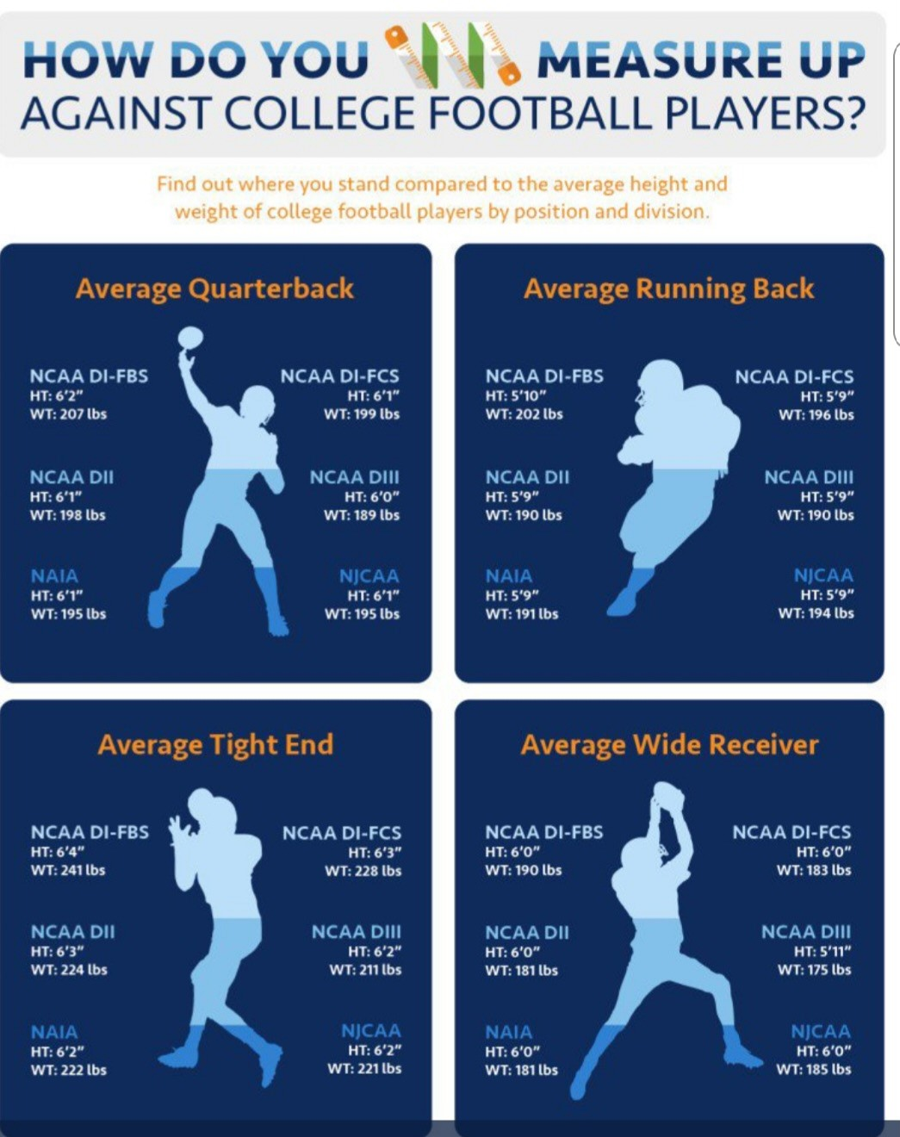
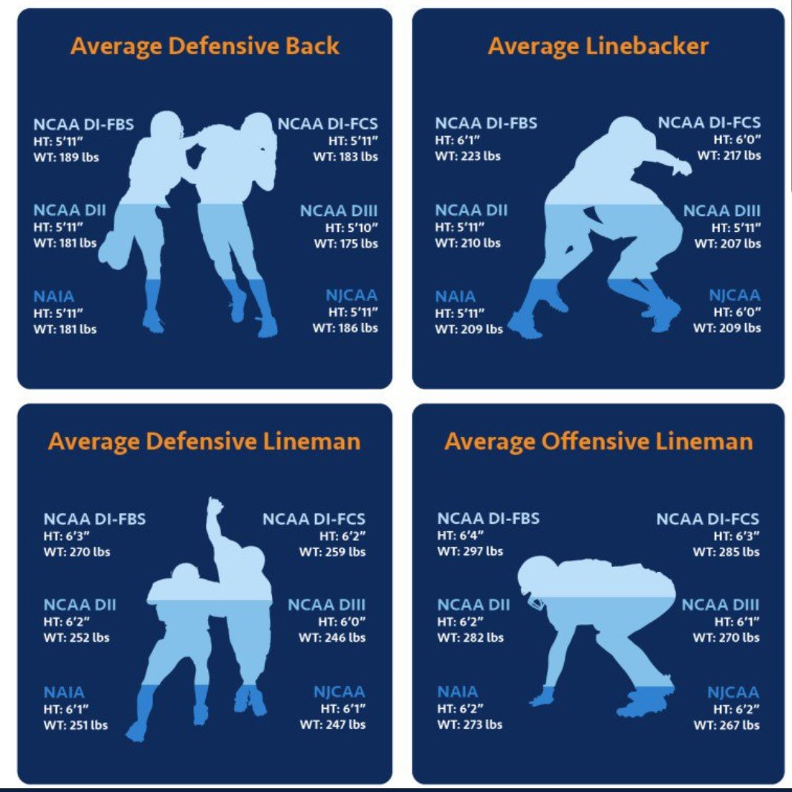

Slide 10
D1 football programs spend big money on recruiting
Big ten mid-American conference
Michigan: $864,492 central mich: $235,450
Michigan state: $827,592 eastern mich: $280,054
Ohio state: $864,152 western mich: $265,001
The champions
Alabama: $1,384,188
Georgia: $1,292,544
**Numbers from 2012-2013**
COLLEGE FOOTBALL IS BIG BUSINESS

Slide 11
DIVISION I FOOTBALL BOWL SUBDIVISION (FBS)
The top level of college football…. (Ohio State, Michigan, Notre Dame)
10 conferences with 130 schools i
85 “full rides”
DIVISION I FOOTBALL CHAMPIONSHIP SUBDIVISION (FCS)
Next level of college football…. Also known as I-AA (Youngstown State, Eastern Kentucky, Dayton, Yale)
125 programs– 63 scholarships – may breakup between players
All leagues allow scholarships with the exception of the Ivy League and Pioneer Football League

Slide 12
DIVISION II FOOTBALL
(Wayne State, Grand Valley State, Findlay)
170 schools
36 Partial-Scholarships
DIVISION III FOOTBALL
NO ATHLETIC SCHOLARSHIPS AWARDED
(Adrian, Alma, Denison, Defiance)

Slide 13
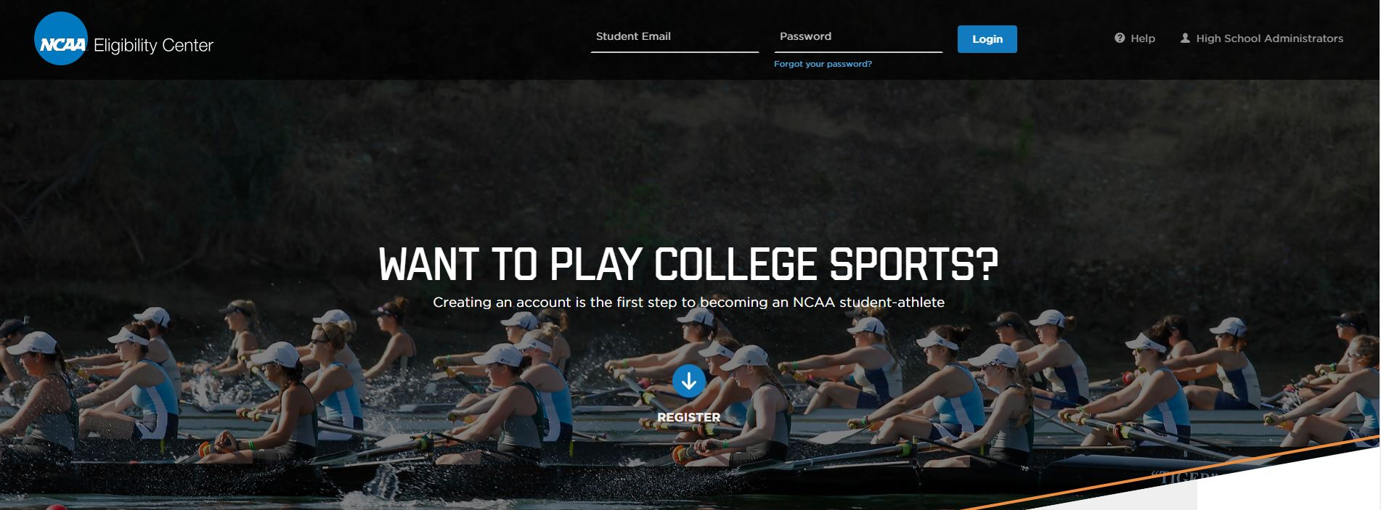
You must be certified by the NCAA Eligibility Center to
compete at an NCAA Division I or II school.
If you want to become a Division III player or are
undecided you can create a profile.
NCAA ELIGIBILTY CENTER

Slide 14
(Concordia, Siena Heights, Lindsey Wilson College)
96 schools
24 Scholarships
To play for an NAIA college a prospect must register with the NAIA Eligibility Center at PlayNAIA.org There is a $75.00 fee

Slide 15
JUNIOR COLLEGE
Students not qualified academically to accept a scholarship can attend junior college in hopes of improving their academic standing.
Some Junior Colleges do give scholarships while others do not.
You must have graduated from high school either with a diploma or a GED to play at a Junior College.
You will be given two seasons of competition in the sport.

Slide 16
PREP SCHOOL
Students that need an additional year of social, academic and/or athletic development.
Typically Prep Schools allow a student athlete to compete in athletics without using a year of eligibility.
Student athletes typically need to have a GPA over 2.2.

Slide 17
Obligation of student athlete
Communicate and work with high school coach dedicate self in classroom – Give yourself an opportunity improve skills (speed & position work) make positive impression - attend camps and combines be honest with college coaches
Build a relationship ~ leave A LASTING IMPRESSION

Slide 18
Role of parents
Stress academics over athletics - work with high school coach encourage camp and combine attendance - do college research make college visits with son put own ego aside Don’t dominate conversations with college coaches – let son do most of the talking
GUIDE THE PROCESS DO NOT BE THE PROCESS

Slide 19
Role of high school coach
Promote players - be honest & realistic with players & parents be honest & upfront with college coaches - be liaison with high school counselors provide film to player & college coaches - prepare players for college visits be an advisory source, not a decision maker for player
BRIDGE THE GAP

Slide 20
KEY TERMS USED IN RECRUITING
PROSPECT: Student who has started classes for 9th grade.
RECRUITING: Solicitation of a prospect by an institutional staff member (coach).
EVALUATION: Coach visits to observe prospect participate in practice or competition.
CONTACT: Pre-arranged (Face-to-Face) meeting between prospect and coach or prospect’s parent and coach.
UNOFFICIAL VISIT: Prospect visits college at own expense.
OFFICIAL VISIT: University all-expense paid trip for prospect and parent for 48 hours - prospect allowed 5 visits – one per college.
ON THE BOARD: Prospect has been determined to be one of interest for possible scholarship offer by university.
OFFER: Prospect given full grant-in-aid offer to attend university they can accept.
NON-COMMITABLE OFFER: College coach tells prospect he’s got full grant-in-aid offer but must do something else before staff will accept.
VERBAL COMMITMENT: Prospect gives verbal non-binding pledge to attend university on full grant-in-aid to play sport and continue academic career.
:
NATIONAL LETTER OF INTENT: Binding contract between prospect and institution signed on first Wednesday in February of prospects senior year.

Slide 21
KEY TERMS USED IN RECRUITING
CONTACT PERIOD: Time allowed for a coach to have in-person contact with prospect or prospect’s parents on or off campus.
DEAD PERIOD: When college coach may not have any in-person contact with prospect or prospect’s parents.
EVALUATION PERIOD: Time allowed for coach to watch prospect play or visit high school. No in-person conversations allowed off campus. Coach can call or write and prospect can visit campus.
QUIET PERIOD: Time when college may not have any in-person talk with prospect/parents off campus. Coach can call or write and prospect can visit campus.
GRAYSHIRT: Scholarship offer when prospect delays enrollment until winter or spring term. Most times when injury has happened during senior year.
GREENSHIRT: When a prospect enrolls one semester ahead of schedule. Also called early enrollment.
BLUESHIRT: Loophole in recruiting that allows college programs the ability of oversigning in a recruiting class. Prospect begins as a walk-on and not brought on scholarship until after first day of fall camp.
SCHOLARSHIP | OFFICIAL VISIT | ENROLLS
EARLY ENROLLEE | YES | SPRING
FALL ENROLLEE | YES | FALL
BLUESHIRT | NO | FALL
GRAYSHIRT | YES | SPRING FOLLOW YR

Slide 22
RECRUITING REPORTING MEDIA
Subscription based business that follows the recruitment of top prospects from across the country. Their job is not to get prospects offers, but college recruiting offices read and follow the activities of prospects on their boards.
What you say in a story can have repercussions if you say something negative or forget to mention a school that is recruiting you.
Top prospects will be contacted by multiple recruiting reporters whose job is to write positives about the school they cover. Main recruiting analyst will write more general content about all schools of interest.
Don’t be afraid to control this aspect of your recruitment and how many reporters you speak with.

Slide 23
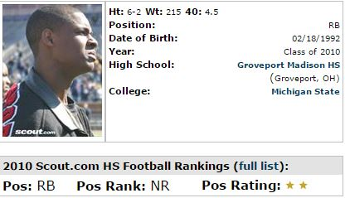
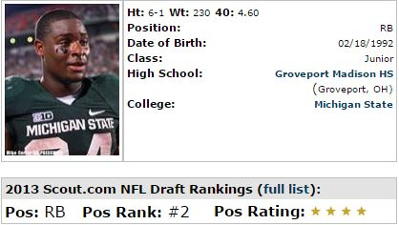
RECRUITING REPORTING MEDIA
How important are “STARS” and rankings in the recruiting process?
Stars and rankings are for fans. Don’t be caught up into thinking stars or a ranking will get you offers. Every year, prospects with rankings and stars don’t end up at D1 programs. The list is long of guys with 2-stars becoming major college and even NFL standouts.
Le’Veon Bell – 2-Star High School / 4-Star NFL Prospect

Slide 24
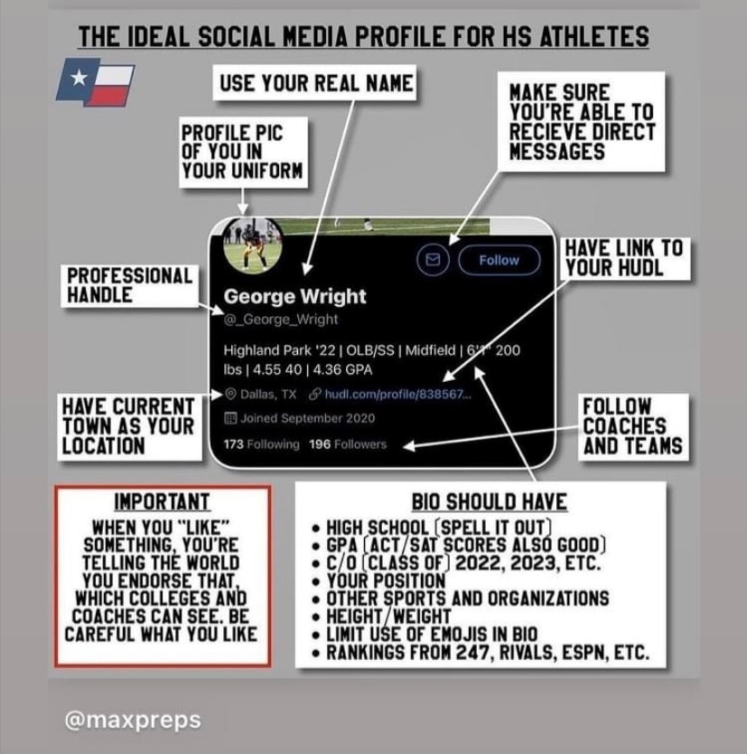

Slide 25
SOCIAL MEDIA
Be visible… If you hide your Facebook profile, you’ll lose the social connections that can help your recruitment. College coaches can use Facebook Messenger to stay in contact with you.
Watch your posts!!!! Bad social media etiquette can bring recruiting to a stop and you’ll never know it.
FACT!!! Photos from a party to an off-color post have the potential to get you in trouble and reflect poorly on you. If you wouldn’t allow your parents to see or ready, don’t post or share. College coaches are making an investment in you as a person when they give you a scholarship. They will pick an athlete with a clean social media profile over one who doesn’t value their online image.
Watch your comments. Be nice. No profanity or anything that is going to draw negative attention to you. Coaches, recruiters, and even admission officials watch comments. No DRAMA as coaches don’t have time to deal with players who will bring drama to their program.
Do promote yourself. Do post positive things you’re doing in the classroom, community or on the field.
Remember, just because you delete a post, it still may be in cyber space to come back and haunt you.

Slide 26
SOCIAL MEDIA
Twitter is the most popular platform for College Coaches. Create a handle that can be identifiable and include Name, High School,
City/State, Grade Year, Position and Hudl Link
Connect with coaches. Watch for college coaches and support staff following you on Twitter. If they follow you, follow back. There is a reason they decided to follow. Follow coaches of programs you have interest in attending. They may not follow back, but they will receive a notice you are following them and will have to look.
Biggest part of Twitter used by college coaches is direct messaging. However, keep in mind they have rules to follow on when they can use direct messaging with a prospect.
Watch what you say. Just like Facebook, anything you tweet or re-tweet is now owned by you. Profanity and negative comments are frowned upon and reflects on you. Attitude and drama just doesn’t play in helping you impress a coach.
Don’t get caught up getting followers from fans of schools. At some point you will be picking one school to attend. All those fake followers will drop you and who knows what they’ll post about you as they go.
Don’t post a Top List of schools at any time during the recruiting process. You can post offers you’ve received but never burn a bridge by leaving a school out of consideration.
Remember: Once a Tweet is out there, it’s out there.

Slide 27
USA TODAY STORY
In a new survey just released, 35% out of 350 college admissions officers across the United States
Admitted to checking an applicant’s social media profile before making a decision on an applicant’s
admission to their university.
When asked, admission officers said social media sites allowed them to get a more authentic and holistic view of applicants beyond the standard applications.
Not only can social media hurt your recruitment, it can keep you from entering a college or taking a job.
USA TODAY STORY

Slide 28
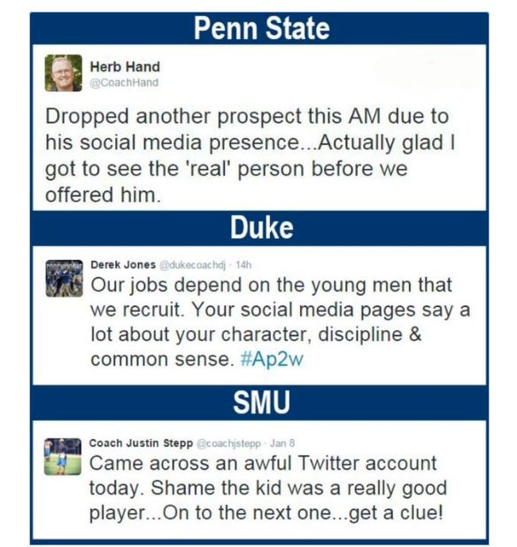
SOCIAL MEDIA
What you post on social media becomes who you are in the eyes of college coaching staffs.
When you re-tweet or share a post from a friend, you take ownership like it was your own post.
Scholarships have been lost from social media as college coaches are putting their trust in you.
You are a major investment for a university and they have to limit their risks.

Slide 29
Identify yourself before the play starts using an arrow or circle.
Use first slide to put name/position ect. No one cares if you earned all conference, your stats ect. They want to see you play. You have on average 45-seconds to grab attention.
Don’t use slow-motion, fast forward or special effects. Some coaches may feel you’ve doctored the film
Place best (Dynamic) plays in first 5-10 plays.
Please, no music no matter how cool you think it might be.
Cut after the important part of your play is seen in the clip. Offensive linemen, college coaches are not looking at the whole clip.
DOs and DON’Ts
No more than 25-30 plays (3-4 mins)
Show different aspects of your game.
Don’t make your highlight private.
Take time to make your highlight.

Slide 30
http://www.hudl.com/v/2AQnvs
http://www.hudl.com/v/2Axcx3

Slide 31
Development ~ Competitive ~ Recruiting Platforms
Local ~ Regional ~ National
**Money Grabs vs Real Impact**
College Football Camps
Mega College Camps
All Star Games
College Showcases
Combines Recruiting Media Showcases 7v 7 Tournaments & Leagues
Camps
Clinics

Slide 32
RECRUITING
RECRUITING consulting
Let you create free profile
Say you are connecting with college coaches
Say you will be discovered by coaches
Have scholarship matching engine
Free evaluation
Will take kids in jr high school
Send mass email to colleges that is never seen
No promises made of getting a scholarship
Sounding board / give advice
Put together a plan to attack recruiting best suited for each prospect
Work one-on-one with prospect & parents
Work to place prospect in position to earn a scholarship or chance to trade football for education money

Slide 33
gameplan
execute
Identify 5 – 8 schools per list (wish list ~ engaged ~ back up
Research majors, social environment, coaching staff and depth chart
Create spreadsheet of coaches contact information including head coach, positional coach and recruiting coordinator of area
Devise an engagement calendar for reaching out via phone, mail, email & social media with strong content and purpose
Schedule next steps & ask tough questions (interest level)
Academics (gpa & ACT/SAT)
Character (on & off the Field)
Athletics (Excel & leave no doubt0
Team team team
Schedule a school visit
Schedule an unofficial visit
Engage and build a relationship
Attend summer camp
ask the hard question
Apply to the school

