Slide 1
leadership
Detroit Catholic Central Football
Online Course 101

Slide 2
Table of contents
1.1 DEFINE A LEADER
1.2 Traditional Definition vs. Your Definition
1.3 Key Characteristics of a GREAT LEADER
1.4 Standing For Something Bigger than Yourself
1.5 Actions Speak Louder than Words
1.6 Goals
1.7 Online Questionnaire

Slide 3
Define a leader
There are 200 different definitions of LEADERSHIP
The person who leads or commands a group, organization, or country.
A person that takes others where they’re not capable of taking themselves
A simple definition is that leadership is the art of motivating a group of people to act toward achieving a common goal. ... They are the person in the group that possesses the combination of personality and leadership skills to make others want to follow their direction.
Leadership is the ability of an individual or a group of individuals to influence and guide followers or other members of an organization.
Great leadership is based on love and courage rather than arrogance or power: love for the other members of the team and the courage to make decisions that are best for the team, even when they are difficult or unpopular.

Slide 4
10 characteristics of a great leader
Honesty and Integrity
(What you do in the dark will come to the light)
Confidence
(Acquired through details, hard work, execution and self esteem)
Inspire Others
(The last guy on the bench should be treated as good if not better than superstar)
Commitment
(There is no grey area, you either are or are not 110% of the time)
Passion
(This can not be faked, is proven through actions not words, its contagious)
Good Communicator
(Have real conversations, truthful conversations and tough conversations. Know when and where to have the conversation)
Decision Making Capabilities
(Lean on those you respect, take advice, put pros and cons on paper and make a thoughtful and caring decision for the overall good of the team)
Accountability
(I am sorry or I am wrong means nothing without follow up actions)
Delegation
(This is a Team game and Team effort, to be your best you must move as a unit. Identify strengths of individuals on team and put them in place to succeed)
Empowerment
(One 4 All, All 4 One – the more unity, synergy and everyone feels part of something bigger than themselves)

Slide 5
How do you want to be remembered
Only something bigger than yourselves will demand the effort from everyone to achieve the greater goal
Having earned the respect and admiration of your peers to the point where they consider you a leader is a great honor. Take pride in that and protect that honor by making good decisions both for yourself and for the good of the TEAM.
A. It means that what you know who you are is just a limited part of yourself that you can experience this physical world. You are not just a physical being but a spiritual being which is eternal having a temporary physical experience. There is a GOD from which everything is created and ultimately will merge with It. So, in that sense we all are part of that Source and our ultimate purpose is to merge with GOD and become One with GOD again, what is known as the experience of enlightenment. In that sense, we are bigger than we know we are right now. We are part of something bigger than who we are now. We are part of GOD and a plan for not one of us but all of us.
B. Sometimes we tend to lock ourselves into the shell of our personalities. We see our lives as if there were boxes spread around you with labels: family; career; health; romance; and even spirituality/community/things-bigger-than-myself. It becomes a struggle to address all these boxes the way you wanted. One of them ends up gathering dust, if not all of them - except the one labeled entertainment/slacking-off. If not by sheer study and failure and awkward attempts on self-improvement, or of a sudden you realize that these are not boxes - they do not belong to you. Every single aspect of your life is part of a greater system. Your career depends on other people. Your health depends on a self-regulating entity that you have little control over called body. Your romantic life depends on partners. And so on. You start to see that your whole life - including your personal tastes and personality - are part of systems within systems within systems.
C. In one word as far as meaning: humility. I suppose we need to contemplate then, how that would both subjectively and objectively manifest. I am in process while at the same time speaking from exposure to information and people. Humility, it has been said, is the recognition of our true human capacity. Even with all of our ingenuity and ability to adapt, Nature's power is humbling. We adapt from nature's resources to our benefit; we also must adapt to Her laws. Destroying or despoiling our home, the Earth, is an expression of lack of humility and gratitude. Nature's example is just one instance.

Slide 6
ACTION > WORDS what you do in the dark, comes to the light
Your thoughts and your words create your actions...always think positively and believe in yourself
You can look at most things in life positively or negatively. Practice is either a burden or an opportunity for you to improve your craft. It’s up to you.
If you want to be a great player, the best way to do that is to be great in everything: school, diet, sleep, character, workouts, competition, gratitude, mindset, coach ability, etc.
You can’t control life. You can try your best to control it, but unpredictable things happen. You can always control how you respond.
Doing What's Right, while others are just Doing
Attendance is a must - no exceptions. You cannot hold others to a standard that you don’t live up to.
Give CONSISTENT maximum effort. You set the standard for how hard our team will work.
Hold yourself and others - especially the other seniors - to the highest standards. Don’t let bad behavior go unaddressed (skipping workouts, skipping reps, giving poor effort, not listening to coaches, etc). These behaviors undermine our team’s ability to reach its goals. Talk to your teammate(s) and address any of these behaviors directly. If the behavior continues, bring it to the attention of the coaches.
Be patient but demanding with underclassmen (“tough love” may come to mind here). Many of them are going through the Varsity Football experience for the first time and are still learning. Keep in mind: no championship was ever won without significant contributions from underclassmen!

Slide 7
Habits & goals
What’s your WHY or PURPOSE?
Habits > Goals
Short Term & Long Term
Know Where You Come From, Be Honest With Where You Are, Plan Where You Are Going
Detailed Map to Where You Are Going
Personal, Spiritual, Academic & Athletic
Identify Weaknesses, Strengths & Resources to Improve
What do you want to accomplish and when?
Write Your Goals Down I Note Cards I Vision Boards
Put Your Goals Up Where You Can See Them Everyday

Slide 8
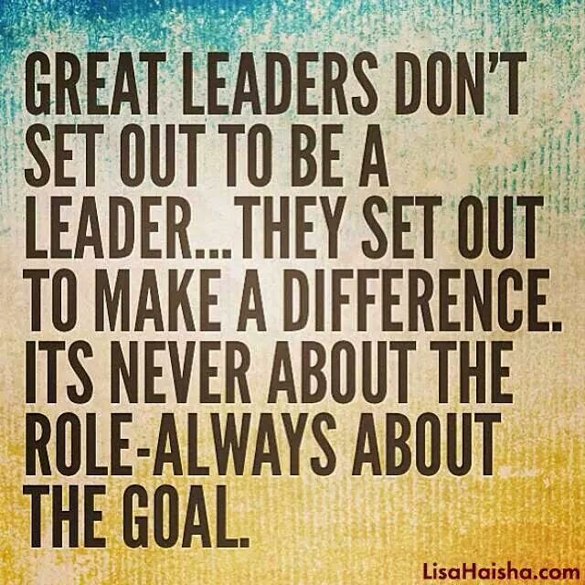

Slide 9
Leadership questionnaire
ONLINE LINK WILL BE PROVIDED

